Slide 1
18CSE487T
Data Warehousing and its Applications
UNIT-1

Slide 2
Data warehouse
A subject-oriented, integrated, time-variant, non-updatable collection of data used in support of management decision- making processes
Subject-oriented: e.g. customers, patients, students, products
Integrated: consistent naming conventions, formats, encoding structures; from multiple data sources
Time-variant: can study trends and changes
Non-updatable: read-only, periodically refreshed
Data Mart
A data warehouse that is limited in scope

Slide 3
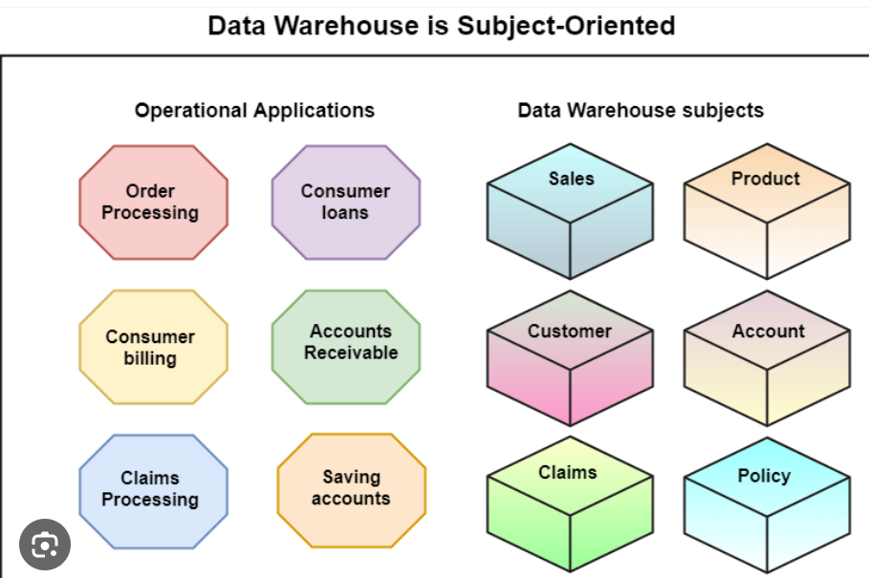

Slide 4
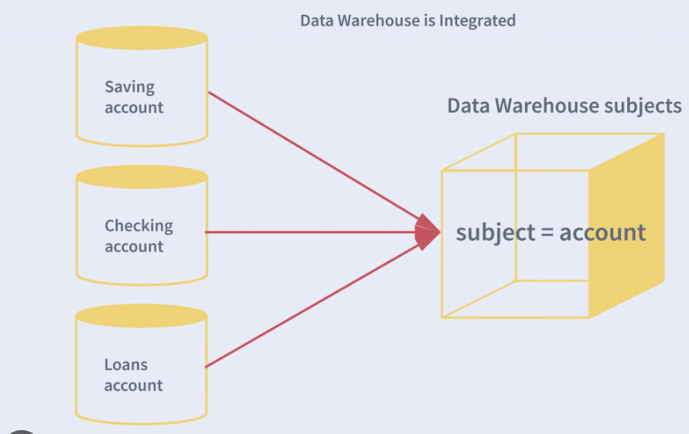

Slide 5
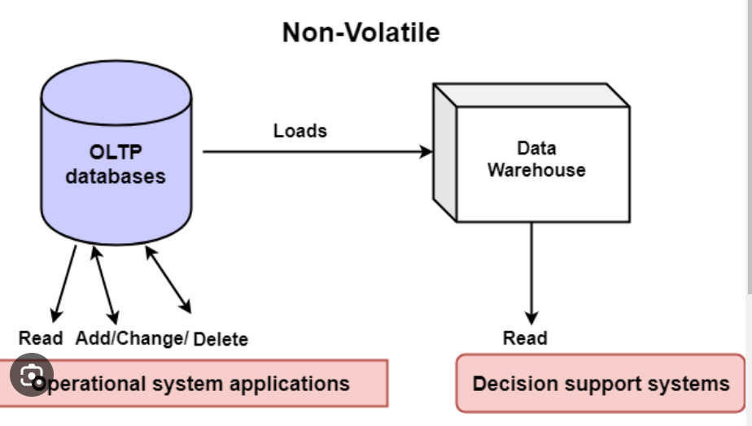

Slide 6
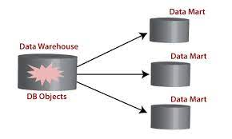
Data mart
A data mart is a data storage system that contains information specific to an organization's business unit.
It contains a small and selected part of the data that the company stores in a larger storage system.

Slide 7
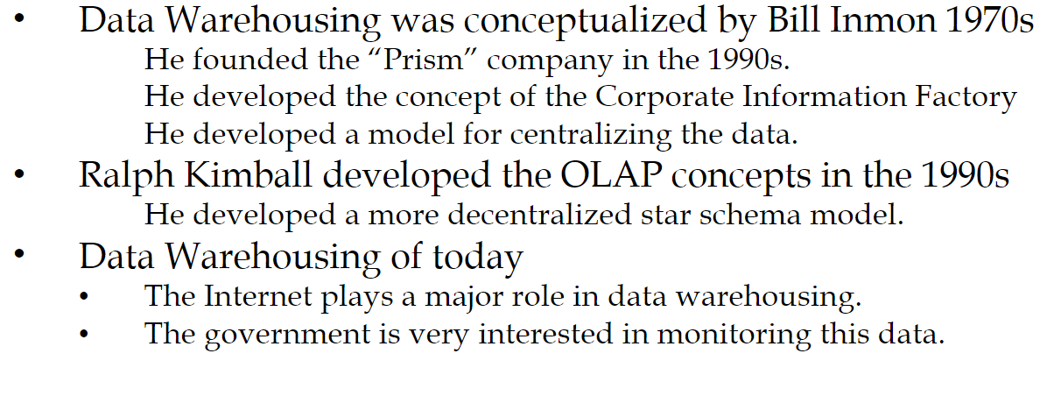
History of Data warehouse

Slide 8

History Leading to Data Warehousing
Improvement in database technologies, especially relational DBMSs
Advances in computer hardware, including mass storage and parallel architectures
Emergence of end-user computing with powerful interfaces and tools
Advances in middleware, enabling heterogeneous database connectivity
Recognition of difference between operational and informational systems

Slide 9
Need for Data Warehousing
Integrated, company-wide view of high-quality information (from disparate databases)
Separation of operational and informational systems and data (for improved performance)
Online Analytical Processing
Decision Making Systems
Data mining

Slide 10
Issues with Company-Wide View
Inconsistent key structures
Synonyms
Free-form vs. structured ﬁelds
Inconsistent data values
Missing data

Slide 11
Datawarehouse Architecture
Data Warehouse processing involves
Data Sources
ETL (Extract, Transform, Load)
OLAP – Data Analytics
Data Mining

Slide 12
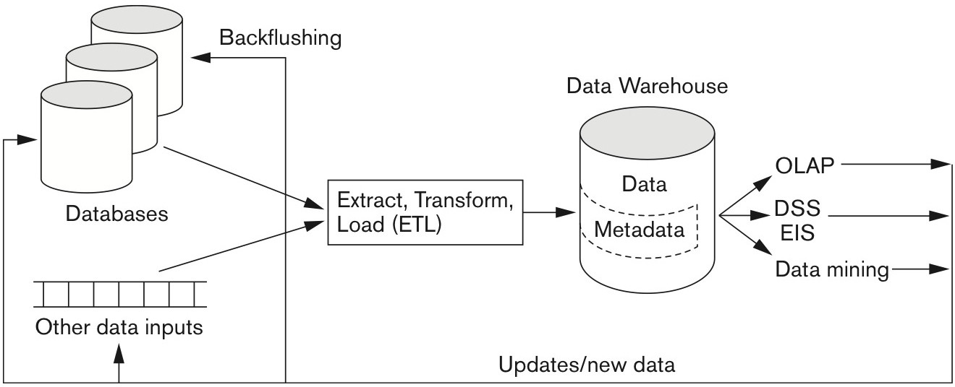
Datawarehouse Architecture (Common)

Slide 13
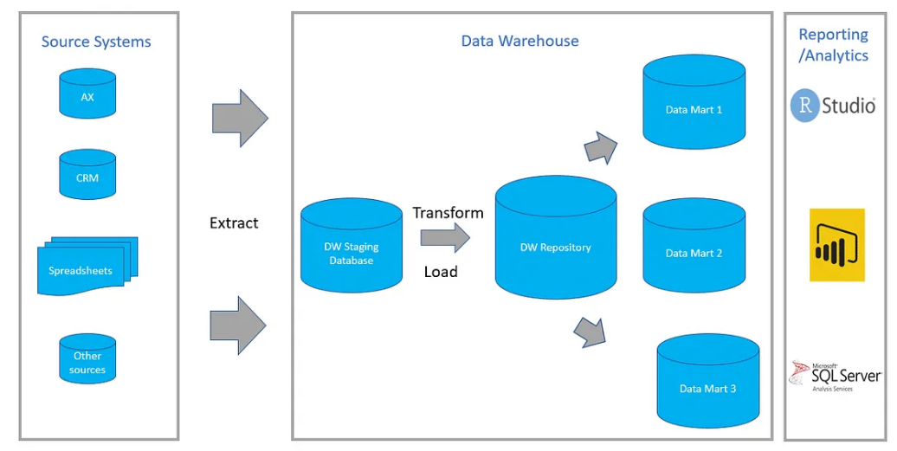
Datawarehouse Architecture

Slide 14
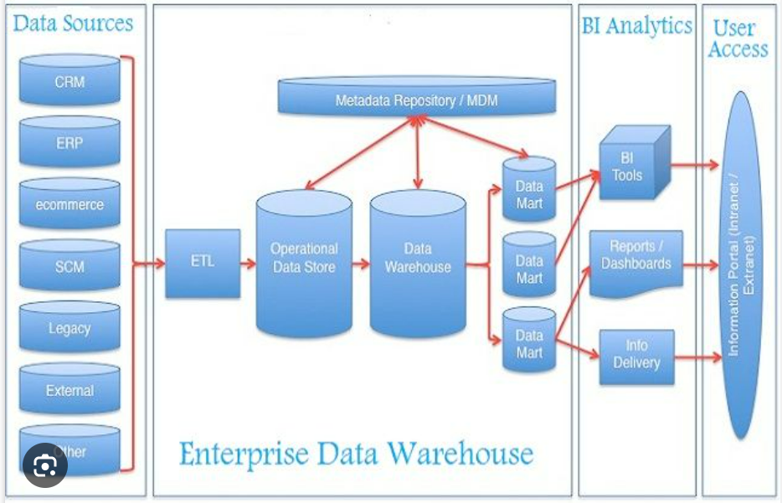
Datawarehouse Architecture

Slide 15
The major components of a data warehousing process
Data sources: internal, external (data provider), OLAP, ERP, Web data
Data extraction and loading: using custom-written or commercial software called (ETL) and loaded into a staging area to be transformed and cleansed, then loaded into the warehouse
Metadata: to ease indexing and search
Middleware tools: to enable access to DW. It includes data mining tools, OLAP, reporting tools, and data visualization tools.

Slide 16
The major components of a data warehousing process
EIS- Executive Information System
Works closely with data warehouses in monitoring business performance as well as identifying problems
DSS- Decision Support System
computer program that makes decisions based on data from internal databases or external databases

Slide 17
Extraction, transformation, and load (ETL)
A data warehousing process that consists of:
Extraction (i.e., reading data from a database),
Transformation (i.e., converting the extracted data from its previous form into the form in which it needs to be so that it can be placed into a data warehouse or simply another database), and
Load (i.e., putting the data into the data warehouse)
During extraction process, the input ﬁles are written to a set of staging tables, to facilitate the load process.

Slide 18
Datawarehouse Architecture types
Data Warehouse Architecture: Basic
Data Warehouse Architecture: With Staging Area
Data Warehouse Architecture: With Staging Area and
Data Marts

Slide 19
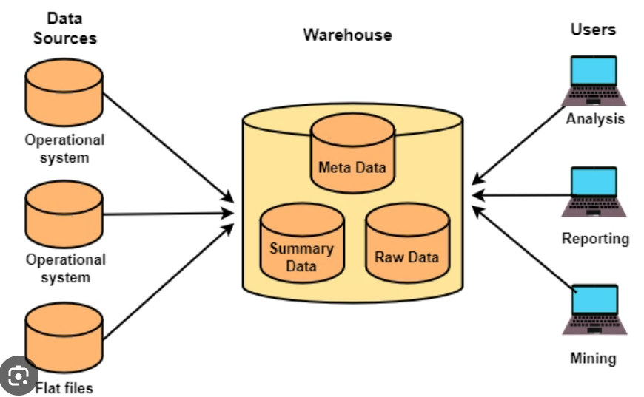
Data Warehouse Architecture: Basic

Slide 20
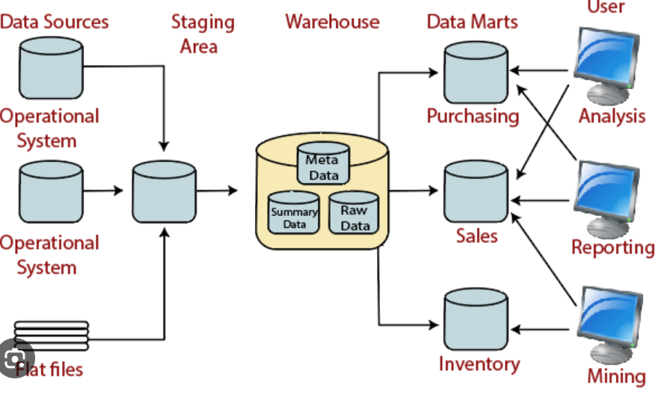
Data Warehouse Architecture: With Staging Area

Slide 21
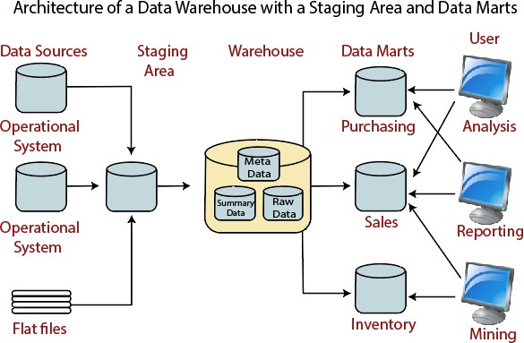
Data Warehouse Architecture: With Staging Area and Data Marts

Slide 22
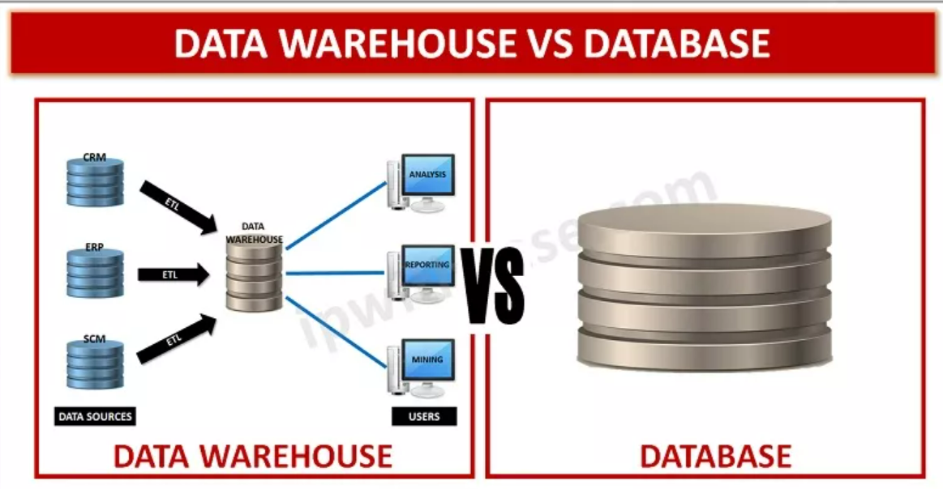
Difference between Database and Data warehouse

Slide 23
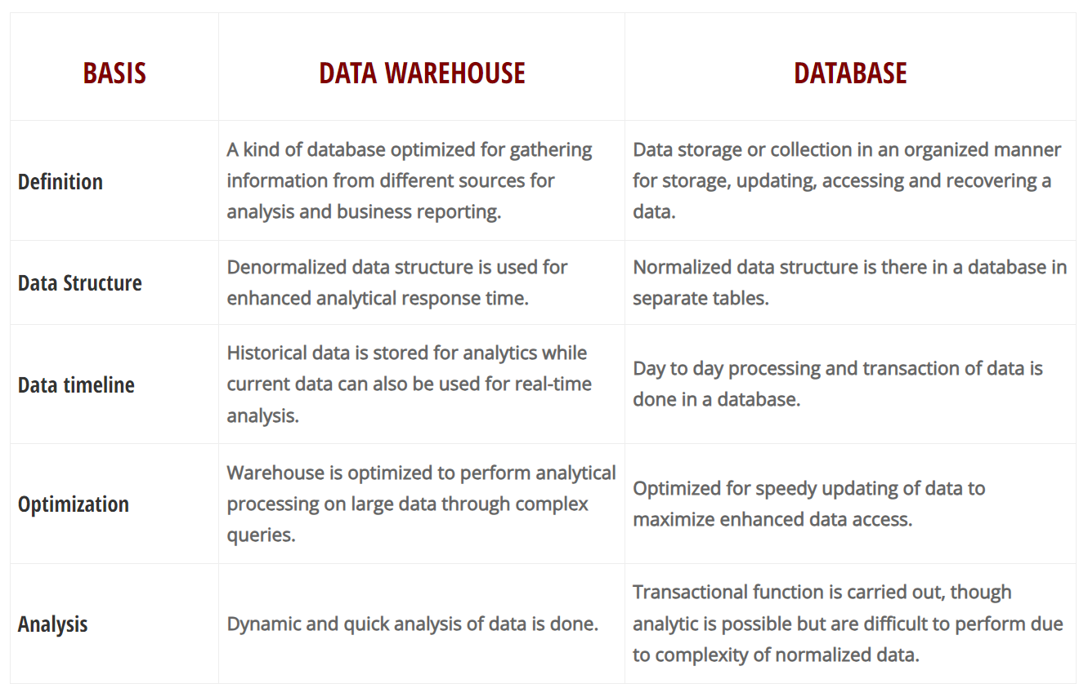
Difference between Database and Data warehouse

Slide 24
Characteristics of Data Warehouses
The following characteristics of Data Warehouses were identiﬁed:
Multidimensional conceptual view
Unlimited dimensions and aggregation levels
Unrestricted cross-dimensional operations
Client-server architecture
Multiuser support
Accessibility
Transparency
Intuitive data manipulation
deductive analysis
Flexible distributed reporting

Slide 25
Data Mart
A Data Mart is a subset of a directorial information store, generally oriented to a speciﬁc purpose or primary data subject which may be distributed to provide business needs.
Data Marts are analytical record stores designed to focus on particular business functions for a speciﬁc community within an organization.
Data marts are derived from subsets of data in a data warehouse, though in the bottom-up data warehouse design methodology, the data warehouse is created from the union of organizational data marts.

Slide 26
Reasons for creating a data mart
Creates collective data by a group of users
Easy access to frequently needed data
Ease of creation
Improves end-user response time
Lower cost than implementing a complete data warehouses
Potential clients are more clearly deﬁned than in a comprehensive data warehouse
It contains only essential business data and is less cluttered.

Slide 27
Types of Data Marts
There are mainly three approaches to designing data marts.
These approaches are
Dependent Data Marts
Independent Data Marts
Hybrid Data marts

Slide 28
Dependent Data Marts
A dependent data marts is a logical subset of a physical subset of a higher data warehouse.
According to this technique, the data marts are treated as the subsets of a data warehouse.
In this technique, ﬁrstly a data warehouse is created from which further various data marts can be created.
These data mart are dependent on the data warehouse and extract the essential record from it.
In this technique, as the data warehouse creates the data mart; therefore, there is no need for data mart integration.
It is also known as a top-down approach.

Slide 29
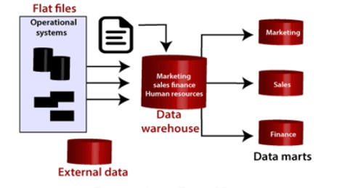
Dependent Data Marts

Slide 30
Independent Data Marts
The second approach is Independent data marts (IDM) Here,
Firstly independent data marts are created, and then a data warehouse is designed using these independent multiple data marts.
In this approach, as all the data marts are designed independently;
therefore, the integration of data marts is required.
It is also termed as a bottom-up approach as the data marts are integrated to develop a data warehouse.

Slide 31
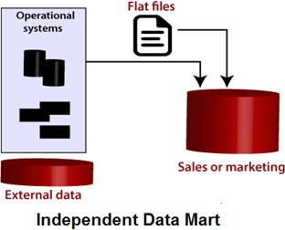

Slide 32
Hybrid Data Marts
It allows us to combine input from sources other than a data warehouse.
This could be helpful for many situations; especially when Adhoc integrations are needed, such as after a new group or product is added to the organizations.
It forms the Datamart's directly from the data source and also from the Datawarehouse.

Slide 33
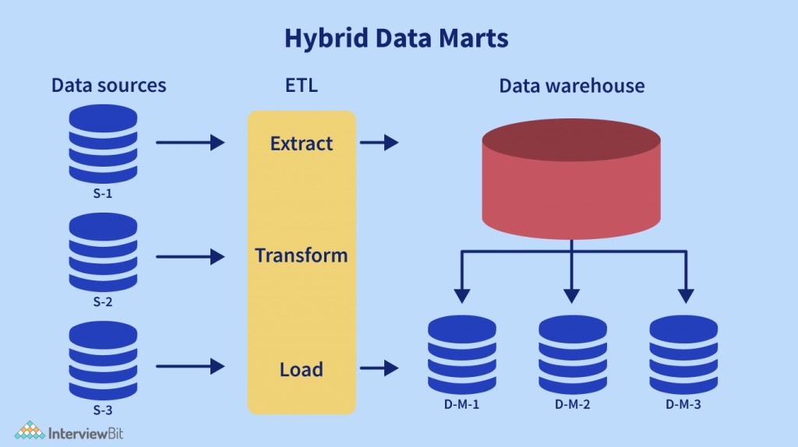

Slide 34
Steps in Implementing a Data Mart
Designing
Constructing
Populating
Accessing
Managing

Slide 35
Designing
The design step is the ﬁrst in the data mart process.
This phase covers all of the functions from initiating the request for a data mart through gathering data about the requirements and developing the logical and physical design of the data mart.

Slide 36
Designing
It involves the following tasks:
Gathering the business and technical requirements
Identifying data sources
Selecting the appropriate subset of data
Designing the logical and physical architecture of the data mart.

Slide 37
Constructing
This step contains creating the physical database and logical structures associated with the data mart to provide fast and eﬃcient access to the data.

Slide 38
Constructing
It involves the following tasks:
Creating the physical database and logical structures such as tablespaces associated with the data mart.
creating the schema objects such as tables and indexes describe in the design step.
Determining how best to set up the tables and access structures.

Slide 39
Populating
This step includes all of the tasks related to the getting data from the source, cleaning it up, modifying it to the right format and level of detail, and moving it into the data mart.
It involves the following tasks:
Mapping data sources to target data sources
Extracting data
Cleansing and transforming the information.
Loading data into the data mart
Creating and storing metadata

Slide 40
Accessing
This step involves putting the data to use:
querying the data, analyzing it, creating reports, charts and graphs and publishing them.

Slide 41
Accessing
It involves the following tasks:
Set up and intermediate layer (Meta Layer) for the front-end tool to use.
This layer translates database operations and objects names into business conditions so that the end-clients can interact with the data mart using words which relates to the business functions.
Set up and manage database architectures like summarized tables which help queries agree through the front-end tools execute rapidly and eﬃciently.

Slide 42
Managing
This step contains managing the data mart over its lifetime.
In this step, management functions are performed as:
Providing secure access to the data.
Managing the growth of the data.
Optimizing the system for better performance.
Ensuring the availability of data event with system failures.

Slide 43
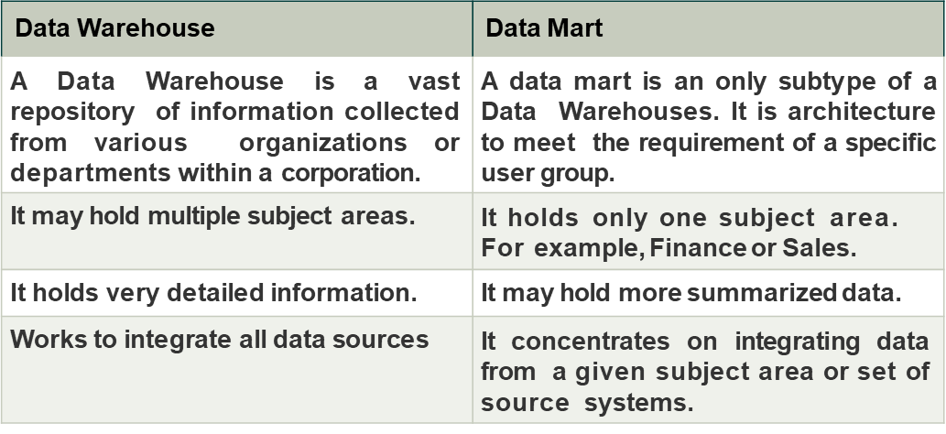
Datawarehouse vs Datamart

Slide 44
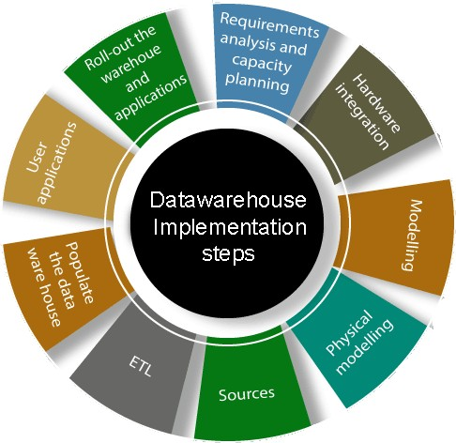
Data Warehouse Implementation

Slide 45
Gathering the business requirement or Requirements analysis:
The first process in data warehousing involves defining enterprise needs, defining architectures, carrying out capacity planning, and selecting the hardware and software tools. This step will contain be consulting senior management as well as the different stakeholder.
Hardware integration:
Once the hardware and software has been selected, they require to be put by integrating the servers, the storage methods, and the user software tools.

Slide 46
Modeling:
Modelling is a significant stage that involves designing the warehouse schema and views. This may contain using a modeling tool if the data warehouses are sophisticated.
Physical modeling or selecting OS and selecting the database software:
For the data warehouses to perform efficiently, physical modeling is needed. This contains designing the physical data warehouse organization, data placement, data partitioning, deciding on access techniques, and indexing. The operating system and software also to be decided properly based on the requirement

Slide 47
Sources:
The information for the data warehouse is likely to come from several data sources. This step contains identifying and connecting the sources using the gateway, ODBC drives, or another wrapper.
ETL:
The data from the source system will require to go through an ETL phase. The process of designing and implementing the ETL phase may contain defining a suitable ETL tool vendors and purchasing and implementing the tools. This may contains customize the tool to suit the need of the enterprises.

Slide 48
Populate the data warehouses:
Once the ETL tools have been agreed upon, testing the tools will be needed, perhaps using a staging area. Once everything is working adequately, the ETL tools may be used in populating the warehouses given the schema and view definition.
User applications and select the end user tools:
For the data warehouses to be helpful, there must be end-user applications and tools. This step contains designing and implementing applications required by the end-users.

Slide 49
Roll-out the warehouses and applications:
Once the data warehouse has been populated and the end-client applications tested, the warehouse system and the operations may be rolled out for the user's community to use.
Data Warehouse Readiness Assessment
examines the state of an organization relative to the delivery of data warehouse solutions

